Slide 1
Book Your ShareTrip

Slide 2
Group Members
011191022 Mohammad Iqbal Hossain Emon
011201056 Md. Mushfikur Talukdar
011191215 Sadia Hassan
011191016 Sanjida Yesmin Ritu
011181081 Tishme Hasan
011192048 SK. Aftab Ali Snigdho

Slide 3
JIRA

Slide 4
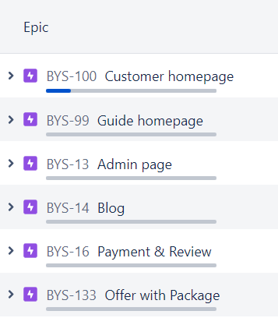
EPIC

Slide 5
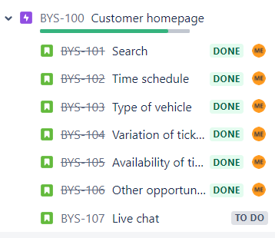
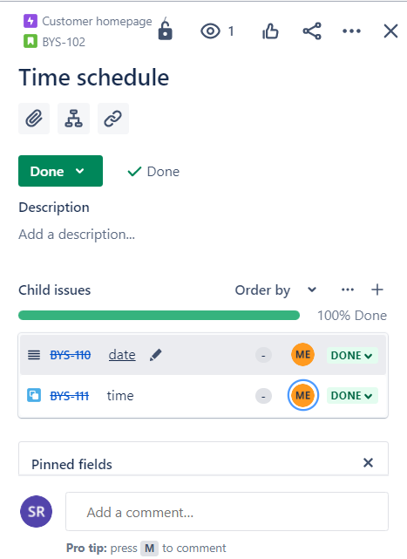
TASK/ISSUE
SUB TASK/ CHILD ISSUE

Slide 6
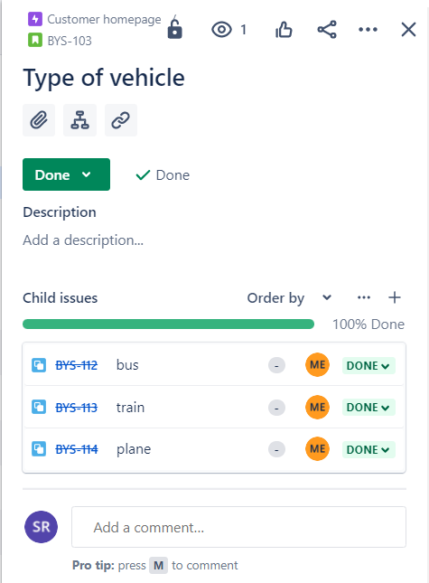
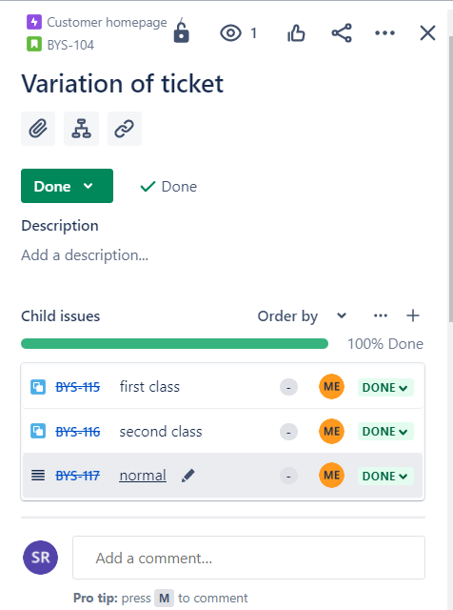

Slide 7
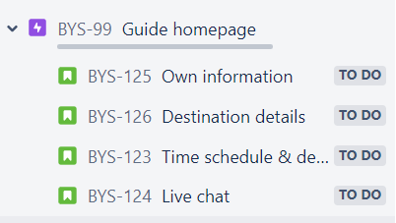
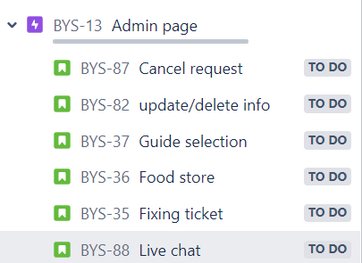

Slide 8
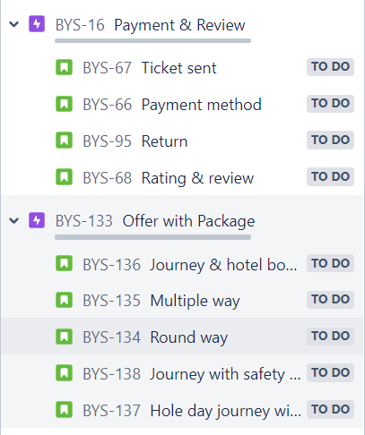
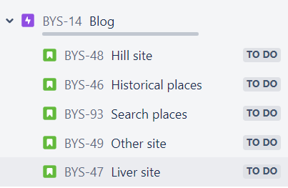

Slide 9
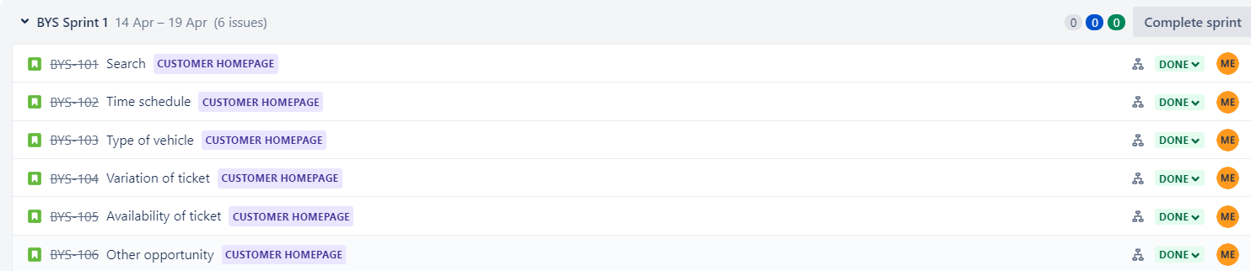
SPRINT

Slide 10
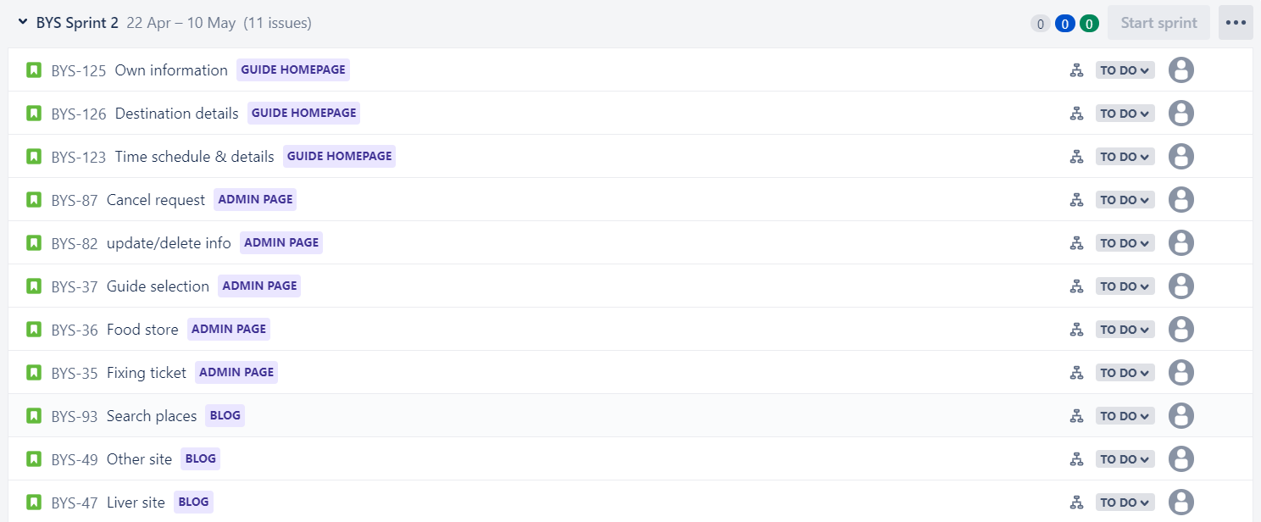

Slide 11
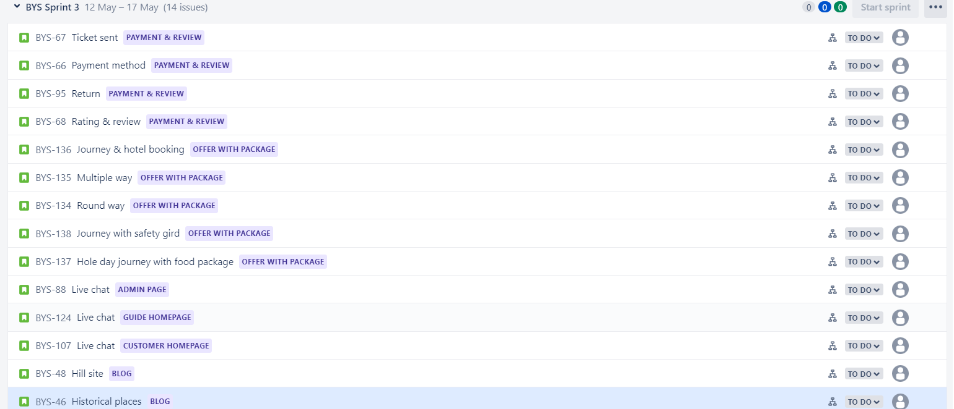

Slide 12
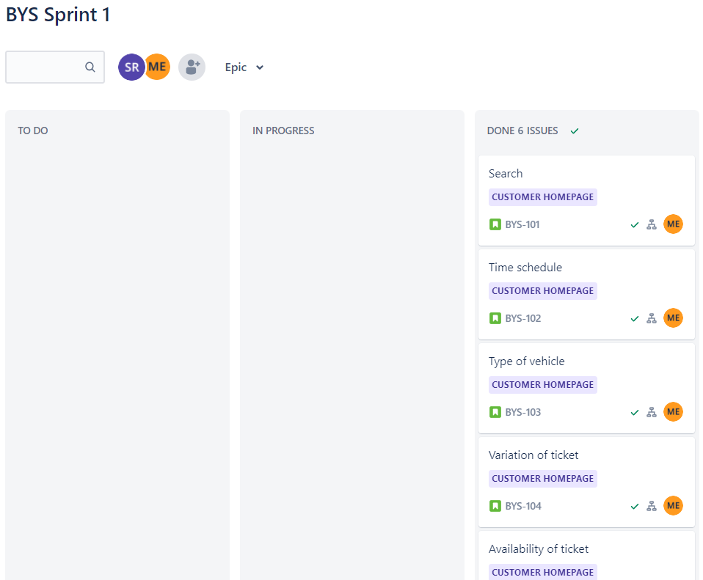
BOARD

Slide 13
Thank You

